Slide 1
Aerial-View Object Classification on BIRDSAI
Hanley, Pierre, Prasad (Group 5)

Slide 2
Background/Theory
“SPOT Poachers in Action: Augmenting Conservation Drones With Automatic Detection in Near Real Time”, Bondi et al, 2018
Discusses use of YOLO and Faster RCNN architectures for object classification using BIRDSAI dataset
“A Survey of Computer Vision Methods for 2D Object Detection from Unmanned Aerial Vehicles”, Cazzato et al, 2020
More generally discusses methods for aerial-view object classification, a brief history of CNN’s, and challenges in UAV object detection

Slide 3
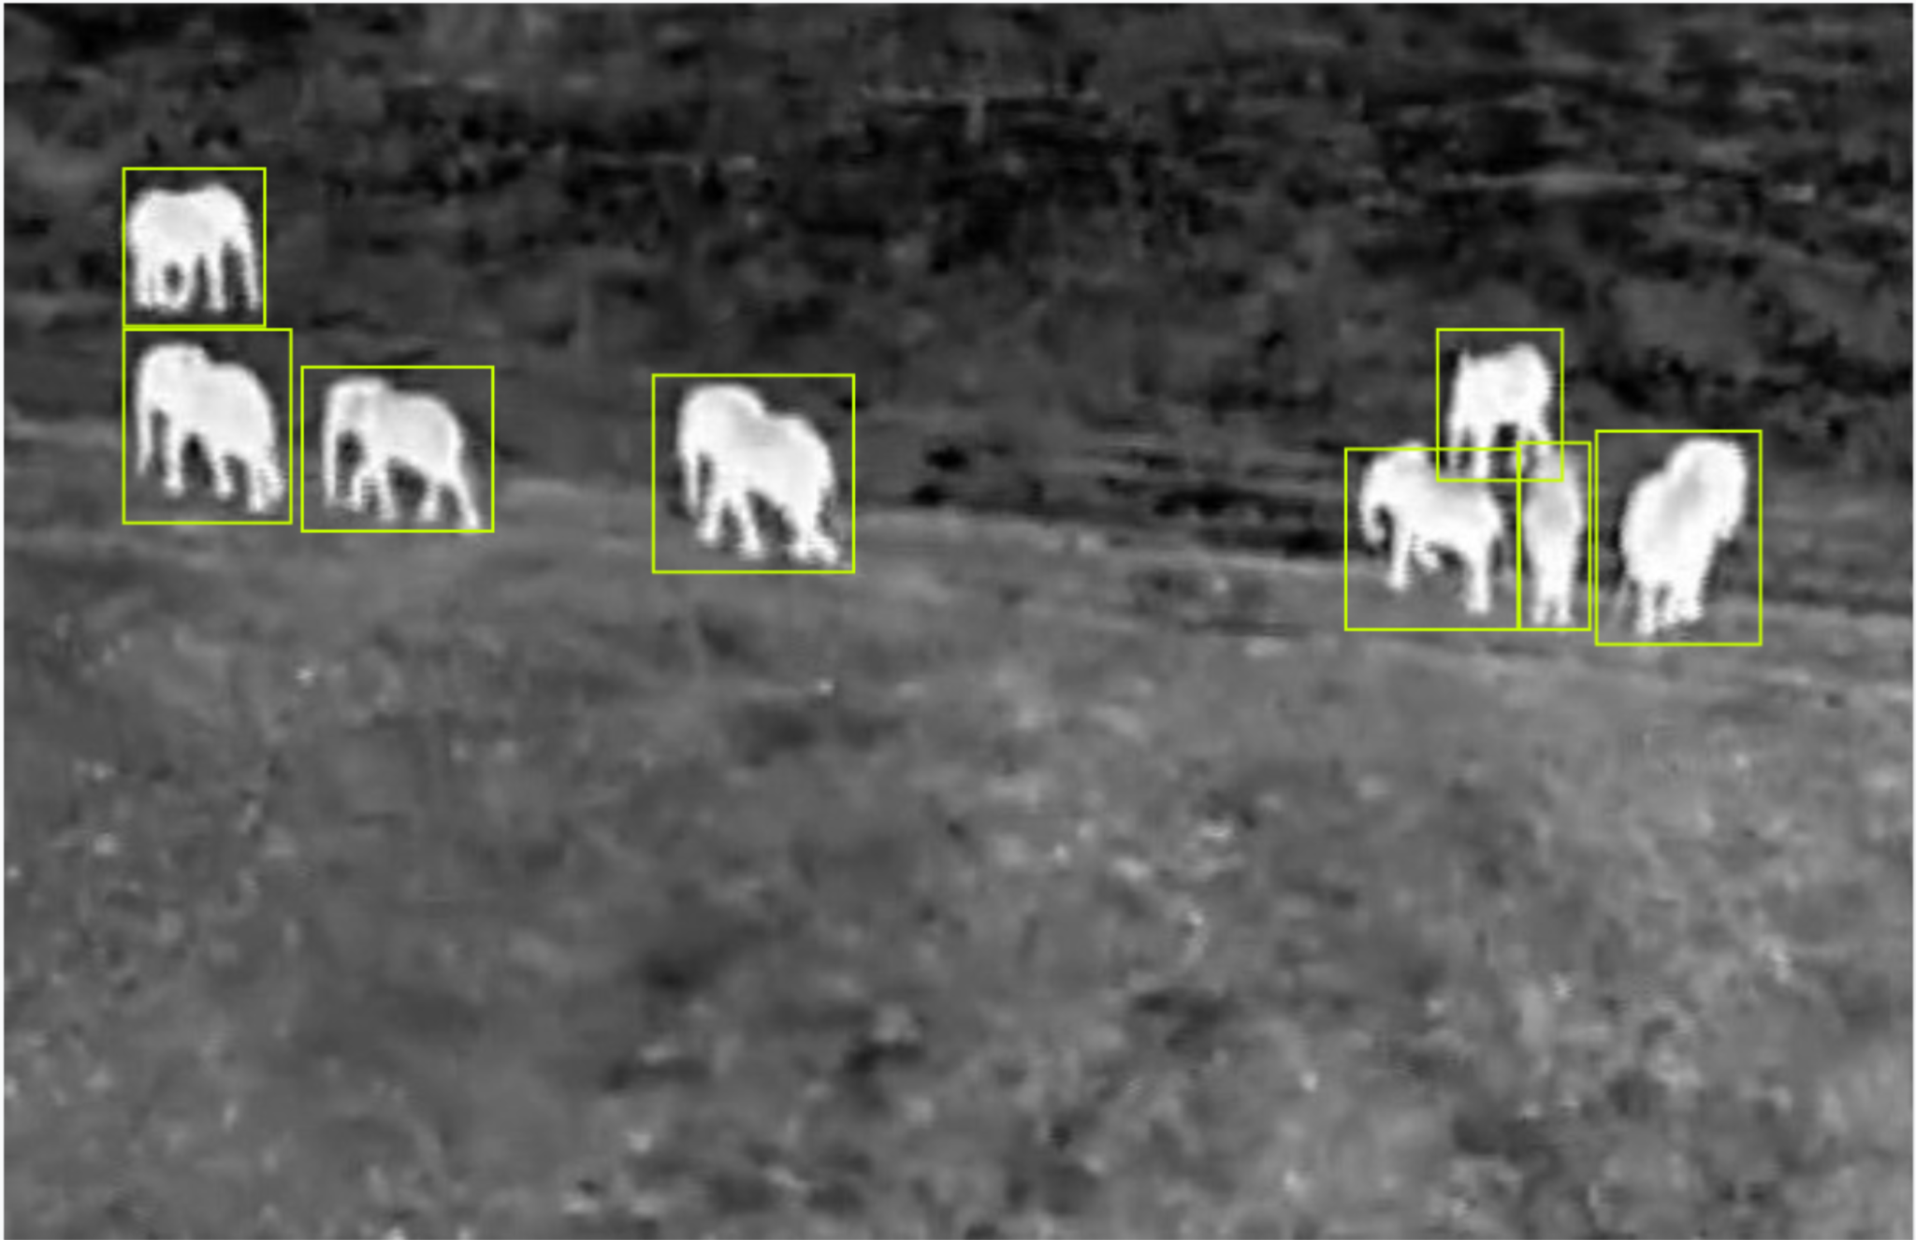
Data
Mixture of real and synthetic videos depicting protected wildlife areas in Southern Africa
Each frame annotated with class labels of either “Human” or “Animal” assigned to bounded boxes
Contains significantly more “Animal” instances than “Human” instances

Slide 4
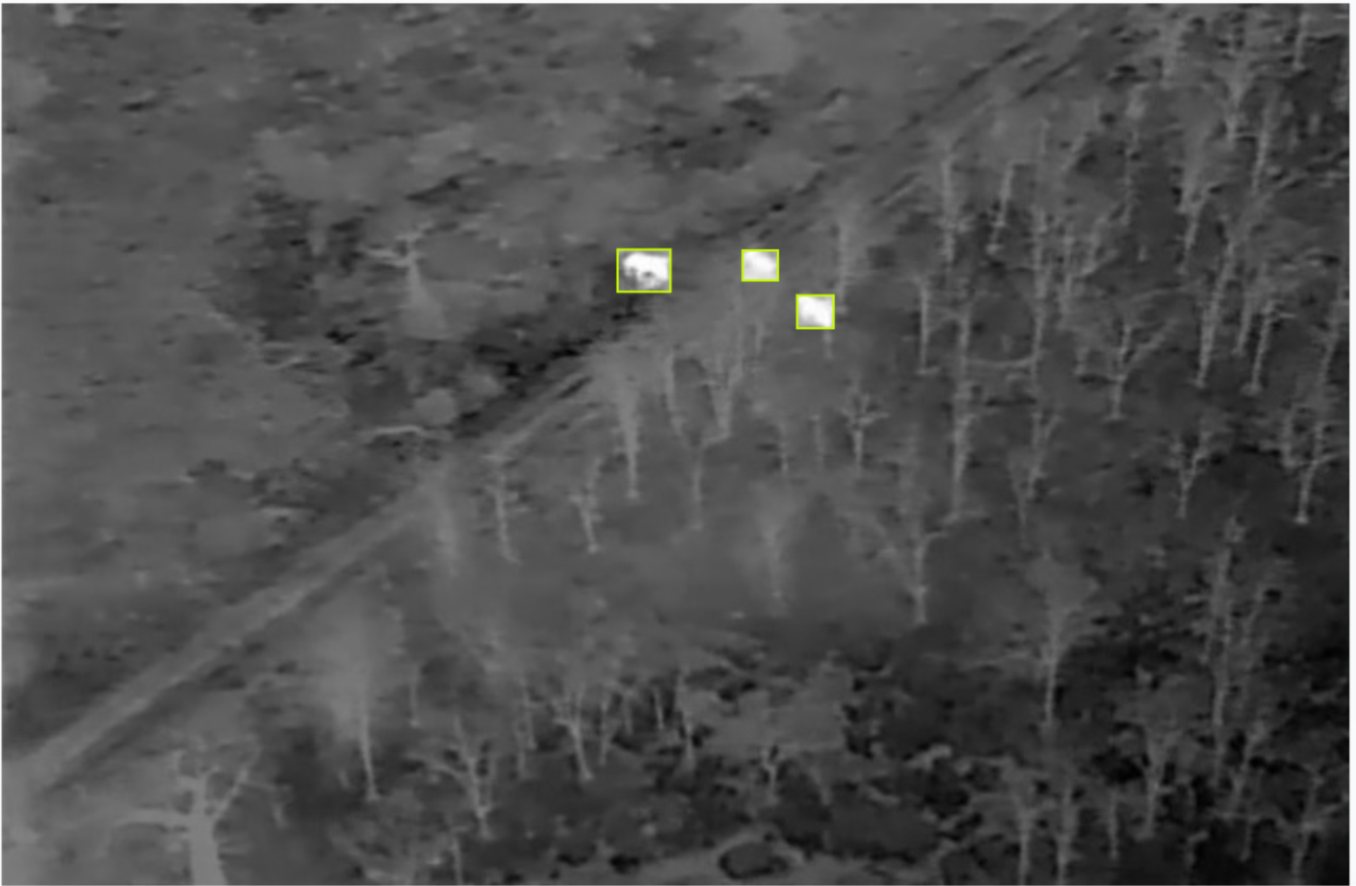
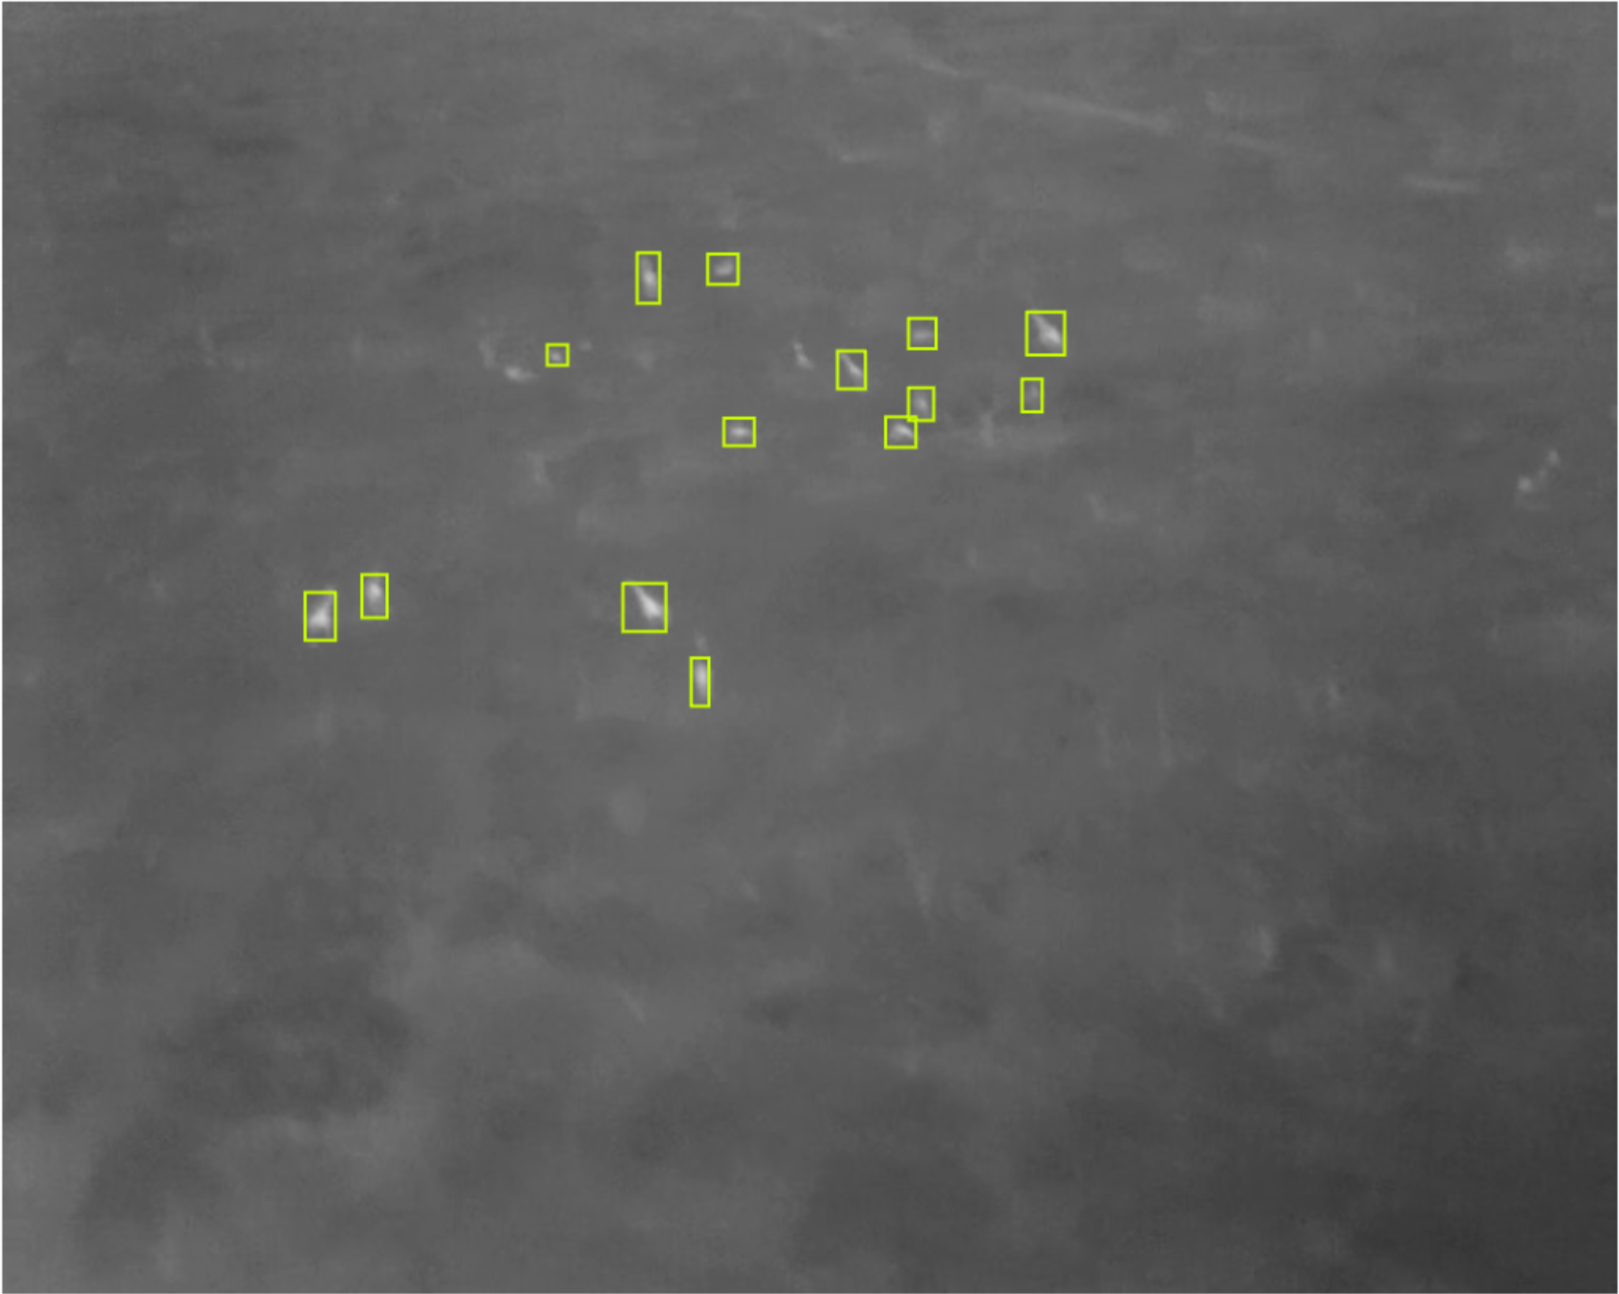
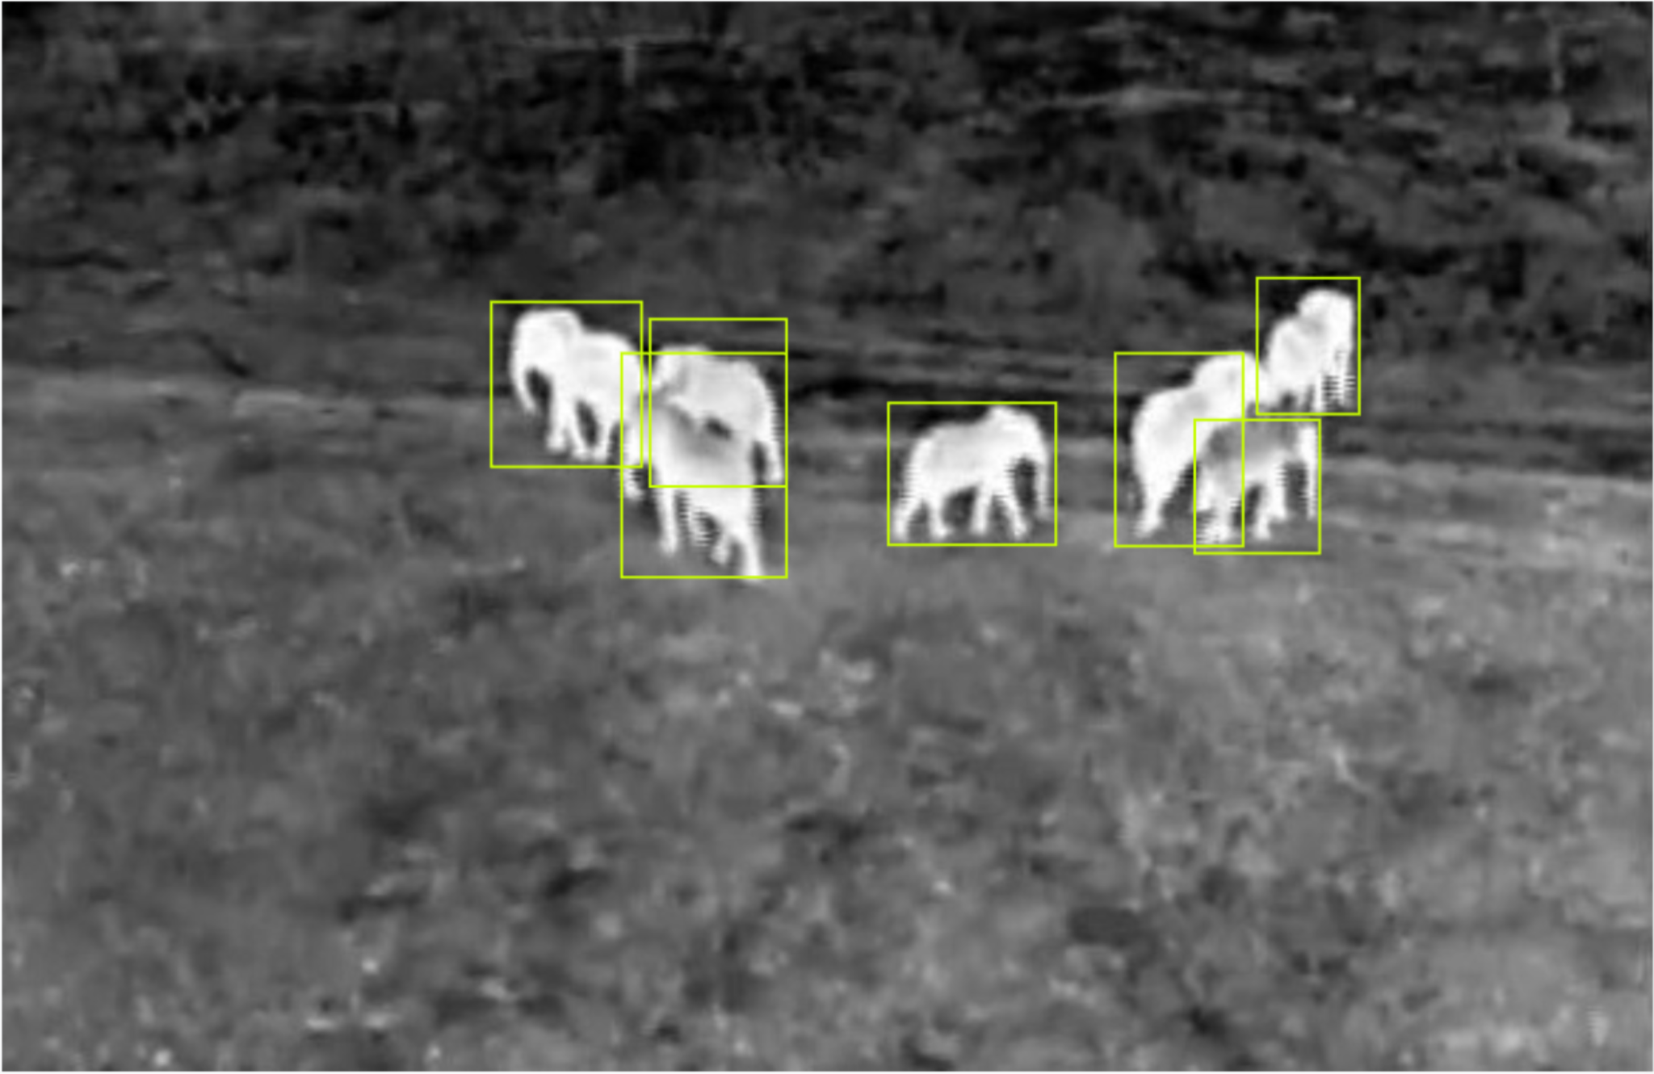
Data
Training data is captured from a variety of vantage points, making it harder to get a good representation of the training data
Fog is present in some images, making classification more difficult

Slide 5
Model
Build off of a pre-trained Yolov5 model
Deep CNN which processes images in a single pass
Outputs bounding boxes and class probabilities, using anchor boxes as reference
CSPDarknet53 backbone
Splits the base feature map into two and merges them, allowing for more gradient flow
Trained using weighted cross entropy loss to account for class imbalance
Uses Adam Optimizer
Notes:
Chose Yolov5 as opposed to other newer models for computational efficiency and speed. The speed is critical for frame-by-frame analysis of videos, which be the use case for this model in the real world
CSPDarknet is a 53-layer neural network backbone

Slide 6
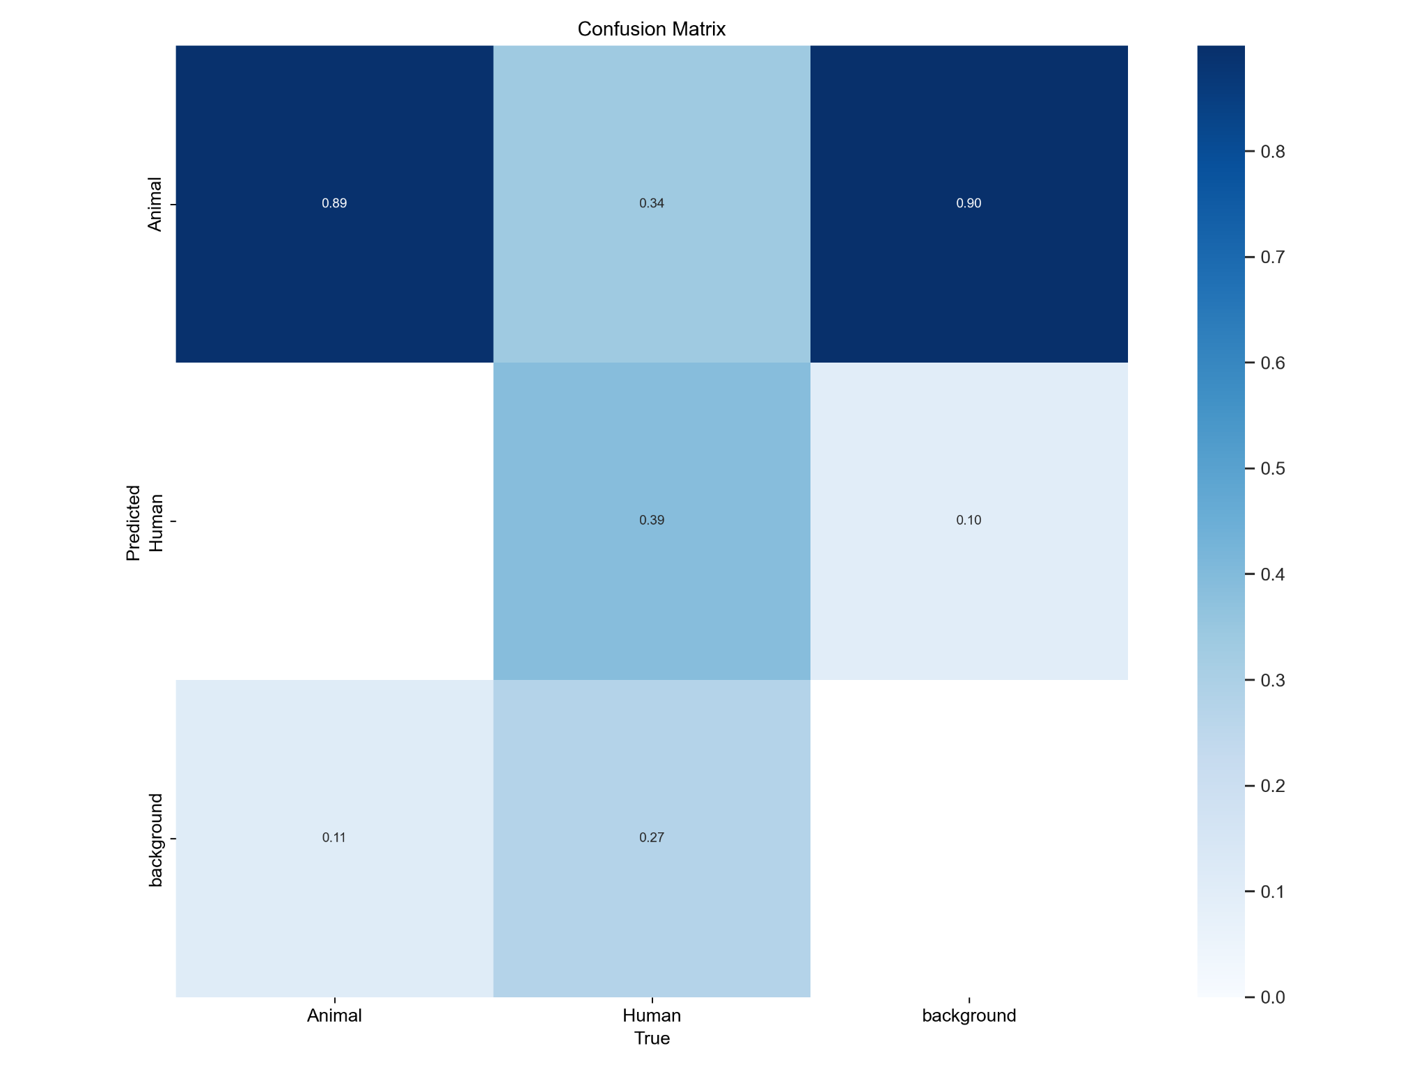
Preliminary Results
Notes:
High background detection as animals as a result of misshaped bounding boxes
Good object detection, poor classification
The "Animal" column and row have high values:
True Animal → Predicted Animal: 0.89 (good)
True Background → Predicted Animal: 0.90 (bad)
True Human → Predicted Animal: 0.34 (moderate misclassification)
This suggests the model might be biased toward predicting “Animal,” which could be due to class imbalance or overfitting to animal features.
Poor Human classification
True Human → Predicted Human: 0.39
True Human → Predicted Animal: 0.34
True Human → Predicted Background: 0.27
This indicates the model struggles to identify humans, often confusing them with animals or even the background. This could be due to:
Insufficient or ambiguous human samples in training.
Overlapping features between humans and animals (e.g., posture, size).
Human annotations might be noisier (e.g., occluded humans).
High background confusion (besides bounding box issues)
True Background → Predicted Animal: 0.90
True Background → Predicted Background: 0.10
Beyond bounding box issues, this might suggest:
Backgrounds contain patterns/features similar to animals (e.g., rocks, bushes).
Model lacks robustness to low-confidence/noisy regions, defaulting to “Animal.”
Class confusion is asymmetric
True Animal is rarely misclassified as Human or Background.
But Background and Human are often misclassified as Animal.
This asymmetry highlights a confidence imbalance in the model: it prefers to “play it safe” and call uncertain regions “Animal.”

Slide 7
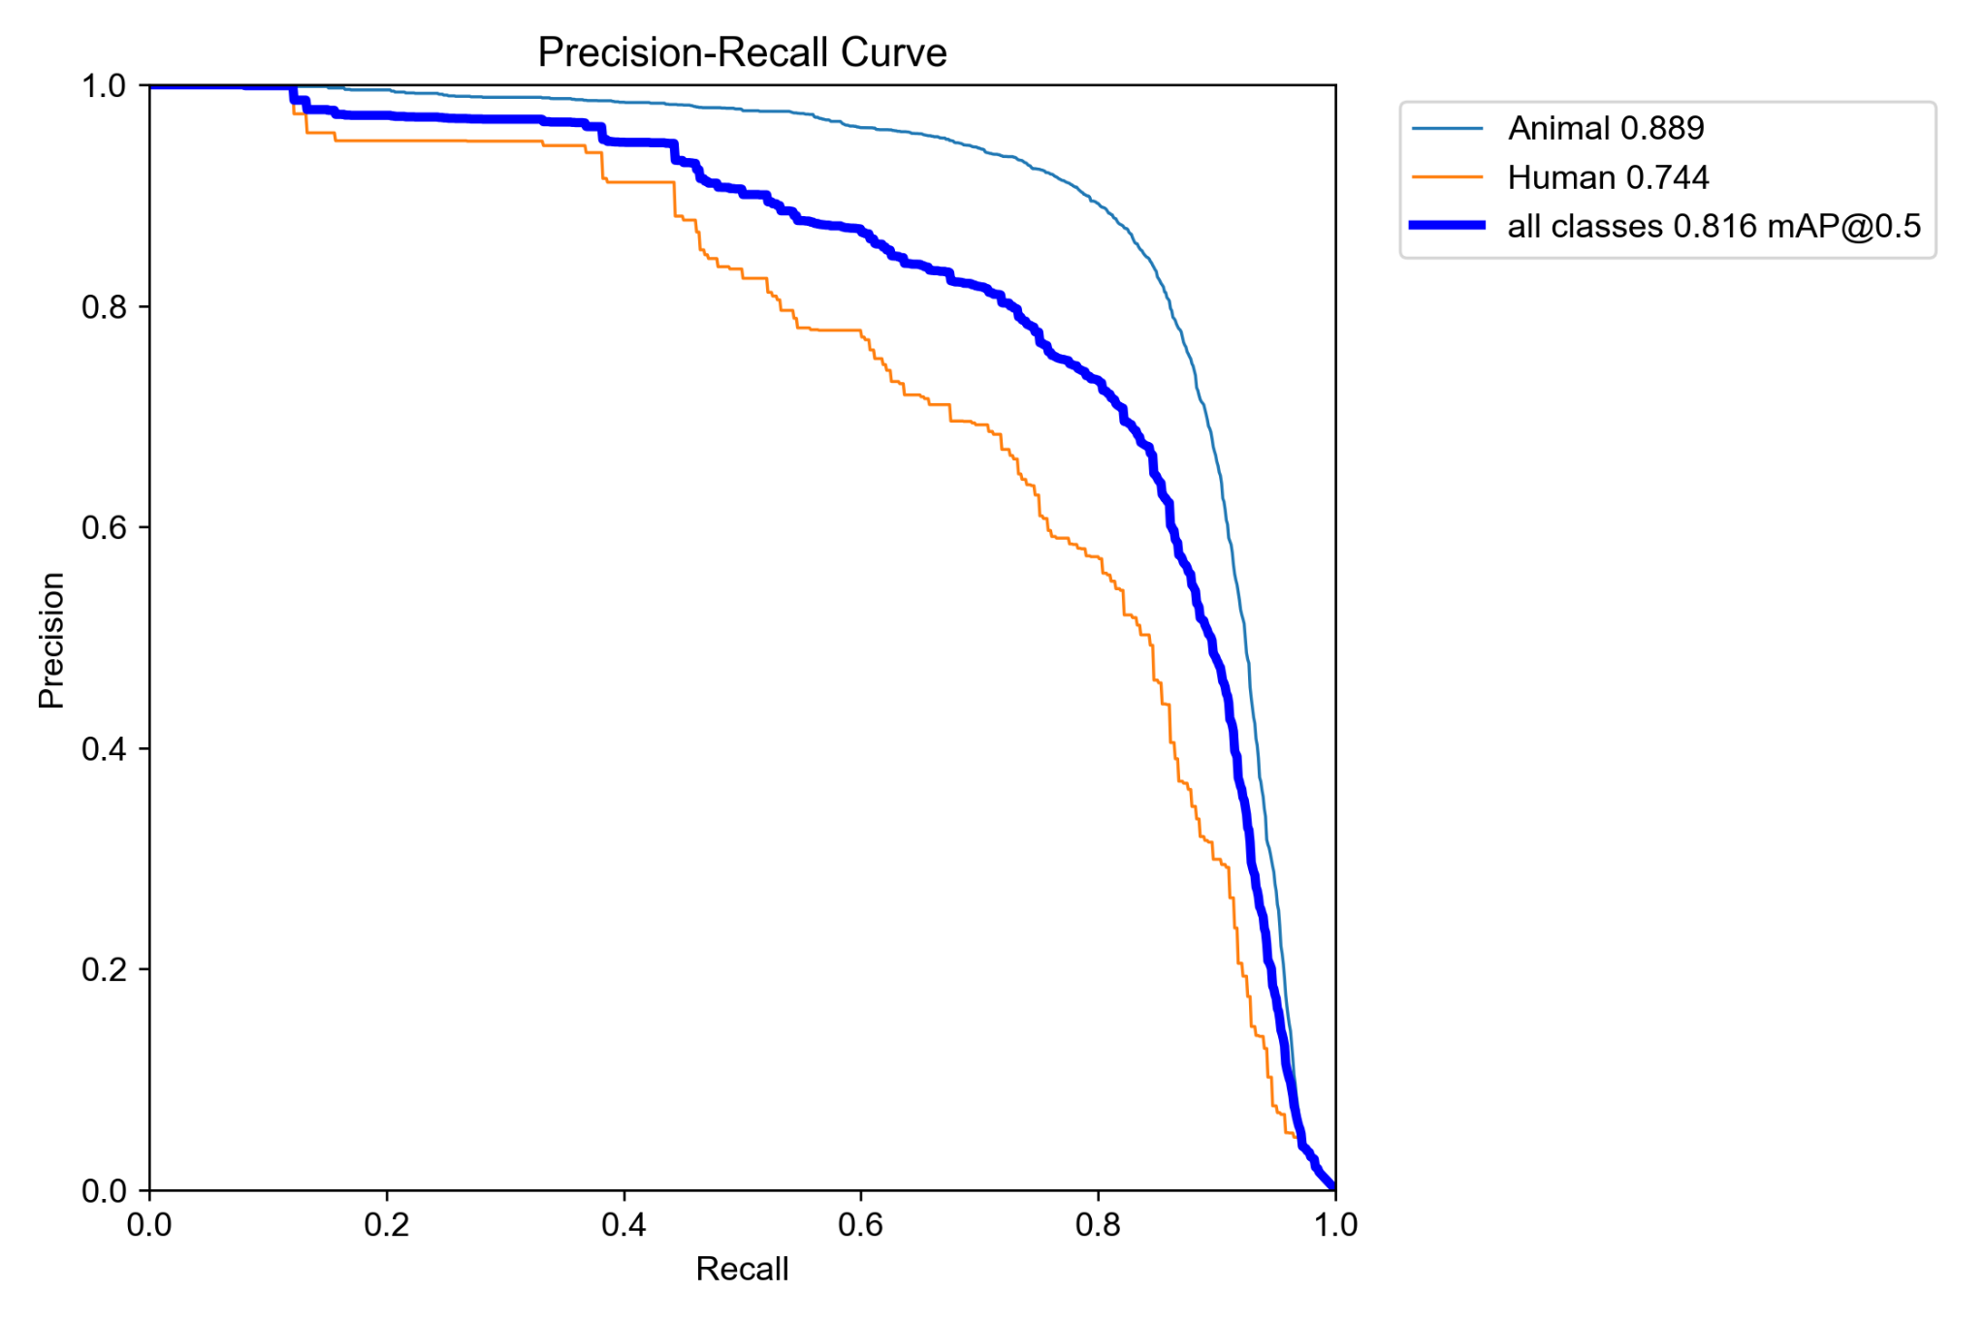
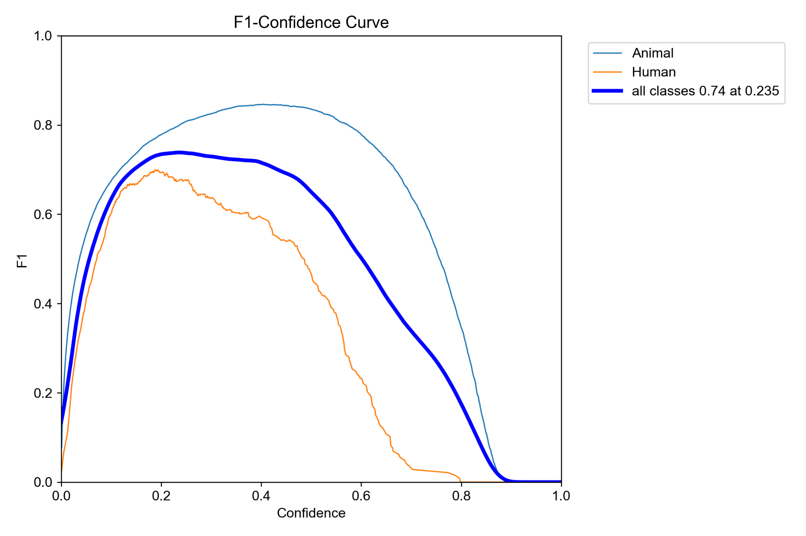
Preliminary Results
Notes:
Classifies animals more effectively than humans
1. Optimal Confidence Threshold for F1 Score
The F1-Confidence Curve (top graph) shows that the highest overall F1 score for all classes is about 0.74, achieved at a confidence threshold of 0.235. This suggests that setting the decision threshold around 0.235 would maximize the balance between precision and recall for your model across all classes.
2. Animal Class Dominates Model Performance
Both the F1-Confidence and Precision-Recall curves show that the model performs significantly better on the Animal class than the Human class. For example, the Animal class achieves a peak F1 score of around 0.85 and a mean average precision (mAP) of 0.889, compared to the Human class's peak F1 of about 0.7 and mAP of 0.744.
3. Precision is High at Low Recall for Both Classes
In the Precision-Recall Curve (bottom graph), both classes start with very high precision at low recall. This means that when the model is very selective (high confidence), its predictions are very accurate, but it may miss many true positives.
4. Steeper Decline for Human Class
The Human class curve drops off more steeply in both F1 and precision as confidence increases or recall increases, indicating that the model struggles more to maintain accuracy for humans as it tries to capture more positives.
5. Overall Model mAP Is Strong
The overall mean average precision (mAP) for all classes is 0.816 at IoU 0.5, which is a strong performance metric. This suggests that, despite the lower performance on humans, the model is generally robust.
6. Confidence Threshold Sensitivity
The F1 score for both classes peaks at relatively low confidence thresholds (around 0.2–0.3). Beyond this, the F1 score drops sharply, especially for the Human class. This indicates the model is more confident (but not necessarily more accurate) at lower thresholds, and a higher threshold may exclude too many true positives.
7. Class Imbalance or Data Quality Issues
The consistent gap between Animal and Human performance may suggest class imbalance in the training data or that distinguishing humans is inherently more difficult for this model, possibly due to less training data, more variability, or poorer data quality for the Human class.

Slide 8
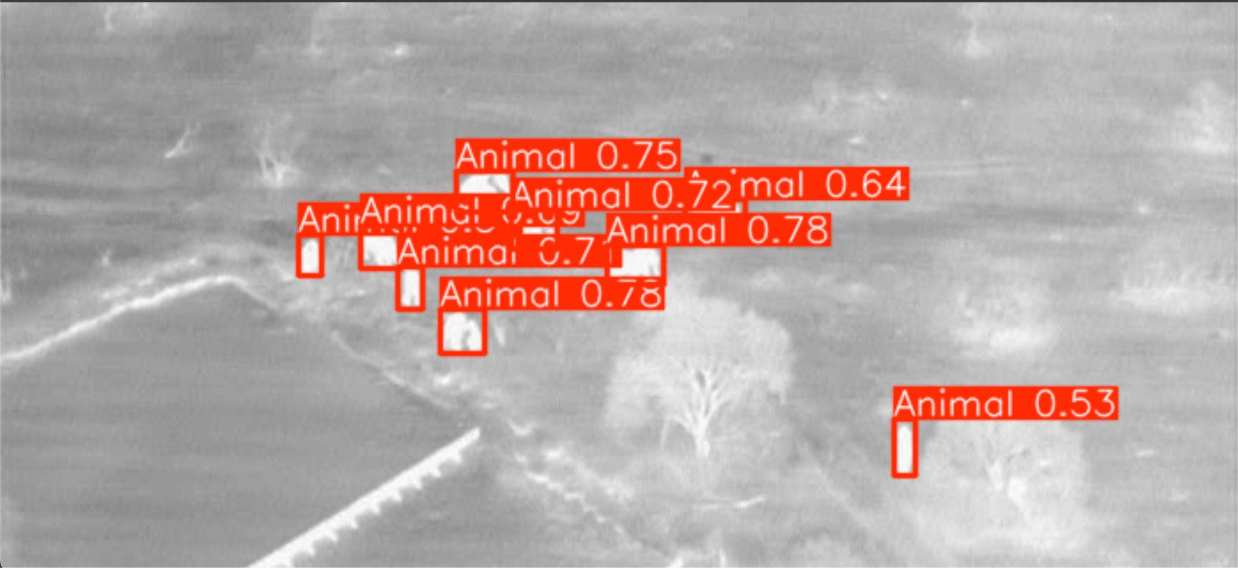
Preliminary Results

Slide 9
Preliminary Discussion
Main Issues:
Misclassification of humans as animals, we plan to address this by weighing misclassifications of humans more heavily using weighted cross entropy
Lack of labeled training data, we plan to address this by utilizing semi-supervised learning to assign labels to unlabeled data

Slide 10
Preliminary Discussion
Real World Application
Analysis of frame-by-frame videos captured by UAVs
Would flag if human presence is detected in x number of successive frames

Slide 11
Works Cited
Bondi et al. “SPOT Poachers in Action: Augmenting Conservation Drones With Automatic Detection in Near Real Time”. Proceedings of the AAAI Conference on Artificial Intelligence, vol. 32, no. 1, Apr. 2018, https://ojs.aaai.org/index.php/AAAI/article/view/11414
Cazzato, et al. “A Survey of Computer Vision Methods for 2D Object Detection from Unmanned Aerial Vehicles.” J. Imaging, vol. 78, no. 6, 2020. MDPI, https://www.mdpi.com/2313-433x/6/8/78.

